Slide 1

SMART FARMER - IOT-ENABLED
SMART FARMING APPLICATION
AND WATER IRRIGATING SYSTEM
ADHIPRASAKTHI ENGINEERING COLLEGE
MELMARUVATHUR - 603 319
GUIDED BY
Dr. MALATHI.M
PROFESSOR,
DEPT. OF E.C.E.
DONE BY
PUGAZHENTHI.K, VISHNU PRASATH S
UG STUDENTS,
DEPT. OF E.C.E.

Slide 2
INTRODUCTION
Smart farming is an emerging field that involves the integration of advanced technologies, such as Internet of Things (IoT), artificial intelligence (AI), and big data, into traditional farming practices.
Smart farming aims to increase agricultural productivity, optimize resource use, reduce waste, and minimize the impact on the environment.
A smart farmer uses these technologies to gather data and insights about the farm, crops, and livestock in real time.
This data can include weather conditions, soil moisture, temperature, and humidity, as well as information about the health and well-being of livestock.

Slide 3
By using this information, the smart farmer can make informed decisions about when to plant, fertilize, irrigate, and harvest crops, and how to manage livestock.
This data can include weather conditions, soil moisture, temperature, and humidity, as well as information about the health and well-being of livestock.
By using this information, the smart farmer can make informed decisions about when to plant, fertilize, irrigate, and harvest crops, and how to manage livestock.
This can help to increase yields, reduce costs, and improve the quality of produce. Smart farming also enables farmers to use resources more efficiently.

Slide 4
ABSTRACT
Smart farming is a rapidly growing field that leverages the power of the Internet of Things (IoT) to optimize agricultural practices and improve crop yields.
By integrating sensors, drones, and other IoT devices, farmers can collect real-time data on soil moisture, weather conditions, and crop health.
This data can then be used to make informed decisions about when to plant, irrigate, and harvest crops.
One of the key benefits of smart farming is that it enables precision agriculture, where inputs such as water, fertilizer, and pesticides are tailored to the specific needs of each crop.

Slide 5
This can lead to significant reductions in waste and environmental impact, as well as improved yields.
In addition to precision agriculture, IoT sensors can also be used to monitor livestock health, reduce feed waste, and optimize productivity.
This can help to improve the overall efficiency and sustainability of the agriculture industry.
Smart farming has significant potential to transform agriculture and contribute to a more sustainable and food-secure future.
By embracing new technologies and innovative practices, farmers can help to address some of the most pressing challenges facing the agriculture industry today, such as resource scarcity, climate change, and increasing demand for food

Slide 6
OBJECTIVES
The Smart Farming has a real potential to deliver more productive and sustainable agricultural production, based on a more accurate and efficient use of resources.

Slide 7
LITERATURE REVIEW
S.NO | TITLE | AUTHOR | YEAR | CONTENTS
1 | Underwater image processing: state of the art of restoration and image enhancement methods | Patil VC, Al-Gaadi KA, Biradar DP, and Rangaswamy M | July 2020. | presented the importance of cloud computing in IoT and the importance of these two technologies in the Agricultural System. In this paper, it is discussed that IoT is closely correlated to cloud computing. The relation between IoT and cloud computing was explained in such a way that IoT gets influential computing tools with cloud computing.

Slide 8
S.NO | TITLE | AUTHOR | YEAR | CONTENTS
2 | Underwater image processing: state of the art of restoration and image enhancement methods | Yan-E D | July 2020. | In his research work, many challenges related to the agricultural domain were, addressed. In this research work, a knowledge base is created. These crop details speak about knowledge acquisition, market availability, geospatial data flow, and weather prediction data. The monitoring module includes monitoring of various stages of growing plant, calamity check, planning for irrigation, crop profit calculation, etc. At last, a comparative study was prepared among several applications of existing developed systems, having properties like efficiency, the knowledge base, reliability, and monitoring modules.

Slide 9
S.NO | TITLE | AUTHOR | YEAR | CONTENTS
1 | Underwater image processing: state of the art of restoration and image enhancement methods | Lee M, Hwang J, and Yoe H | July 2020. | In this paper, an application for precision agriculture, a customized architecture for agriculture, based on IoT is presented. This is a cloud-based IoT architecture. The research proposed a three-layer architecture. The first layer collects the environmental information and supplies for needed actions. The second layer is a gateway layer, this layer connects the front-end and back-end via the Internet or network in which data can be stored and processed. The efficiency of the proposed architecture is demonstrated by the performance evaluation results.

Slide 10
EXISTING SYSTEM
The existing system in smart farming involves a combination of traditional farming practices and modern technologies.
In traditional farming, farmers rely on their knowledge and experience to make decisions about planting, fertilizing, irrigating, and harvesting crops.
They may also use basic tools and equipment, such as plows and tractors, to manage the land and crops.
In modern smart farming, farmers integrate advanced technologies into their farming practices to improve efficiency and productivity

Slide 11
DISADVANTAGES
Overall, the existing system in smart farming is a combination of traditional farming practices and modern technologies, intending to improve efficiency, productivity, and sustainability in the agriculture industry.

Slide 12
PROPOSED SYSTEM
Subscription-based application for providing analysis of crops and fields.
The smart farming devices are designed in such a way that should be profitably compared to traditional farming methods and the device should be reusable.
An easy and simple setup is required and less number of connections and sensors are used for efficient performance.
Everything can be controlled from anywhere through the cloud.

Slide 13
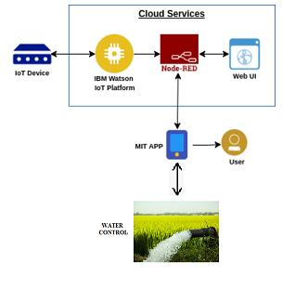
BLOCK DIAGRAM

Slide 14
IOT SENSORS
IoT (Internet of Things) sensors are devices that are used to collect data from the environment and transmit it to an IoT network or platform for analysis and action.
These sensors can be used in a variety of applications, including smart homes, smart cities, and smart farming.
In smart farming, IoT sensors are used to gather data on a variety of factors that can impact crop growth and health, including soil moisture, temperature, humidity, light intensity, and air quality.
These sensors can be placed throughout the farm, either in the soil or above ground, to collect data in real time.

Slide 15
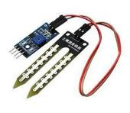
Soil Moisture Sensors
These sensors measure the moisture content of the soil, helping farmers to determine when and how much to irrigate their crops.
JXBS-3001-TR-I20 Sensor

Slide 16
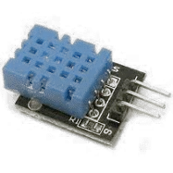
Temperature Sensors
These sensors measure the temperature of the soil and air, helping farmers to monitor and manage growing conditions.
DHT 11 Temperature Sensor

Slide 17
PYTHON SOFTWARE
Python is a high-level programming language that is widely used in a many disciplines, such as scientific computing, data science, machine learning, and web development.
It was first released in 1991 by Guido van Rossum, and has since grown in popularity due to its simplicity, readability, and versatility.
Some of its best usage are Easy to read syntax, Interpreted language, Large standard library, Cross-platform compatibility, Object-oriented programming.

Slide 18
IBM WATSON IOT PLATFORM
The IBM Watson IoT Platform is an IoT (Internet of Things) platform that allows businesses to connect and manage devices, sensors, and other IoT assets.
The platform is designed to help organizations collect, store, and analyze data from IoT devices to gain insights and make informed decisions.
The IBM Watson IoT Platform can be used in a variety of industries, including manufacturing, healthcare, transportation, and agriculture.
In smart farming, the platform can be used to collect data from IoT sensors and devices, such as soil moisture sensors, weather stations, and drones, and use that data to optimize farming practices, improve efficiency, and reduce waste.
By leveraging the capabilities of the IBM Watson IoT Platform, farmers can gain insights into their crops and farming practices, leading to better decision- making and improved yields.

Slide 19
NODE RED
Node-RED is a visual programming tool for IoT (Internet of Things) applications.
It provides a web-based flow editor that allows users to create, deploy, and manage flows that integrate different devices, services, and APIs.
Node-RED was developed by IBM and is now an open- source project under the Node.js Foundation.

Slide 20
MOBILE APPLICATION
A farming mobile application is a software application that can be installed on a mobile device such as a smartphone or tablet and used by farmers to manage their farming activities.
These applications can provide a range of features to farmers such as crop management, weather forecasting, pest and disease identification, soil analysis, and financial management.
Some of the key features of a farming mobile application are Soil analysis, Weather forecasting and Crop management.

Slide 21
SUBSCRIPTION BASED LOGIN
Firebase Authentication provides a simple way to add user authentication to your app. With Firebase Authentication, users can create accounts with email/password or using their existing social media accounts such as Google, Facebook, Twitter, and more.
You can use Firebase Authentication to authenticate users and then use the Firebase Realtime Database to store and retrieve user data.
Overall, implementing a subscription-based login system using Firebase is a great way to monetize your app while also providing a valuable service to users.

Slide 22
WATER IRRIGATION SYSTEM
Water control is the management and regulation of water resources to meet various needs such as agricultural, industrial, municipal, and environmental.
Water control can involve the storage, diversion, distribution, and use of water for various purposes.
In agricultural water control, the management of water resources is critical for crop production.
Farmers need to ensure that water is delivered to their crops at the right time, in the right amounts, and with the right quality.

Slide 23
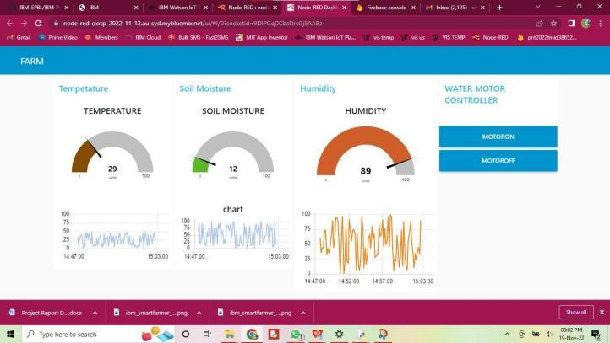
RESULT
NODE RED DASHBOARD

Slide 24
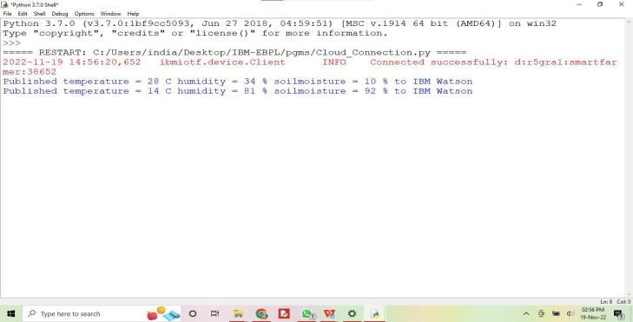
RESULT ON PYTHON WINDOW

Slide 25
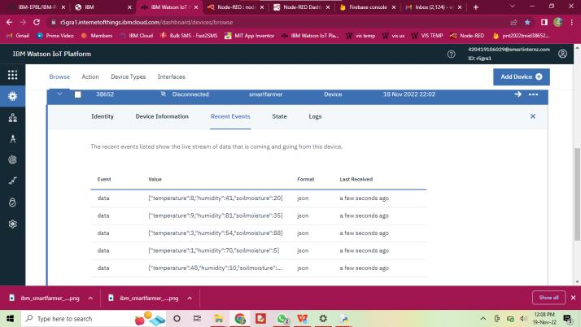
RESULT ON IBM WATSON CLOUD

Slide 26
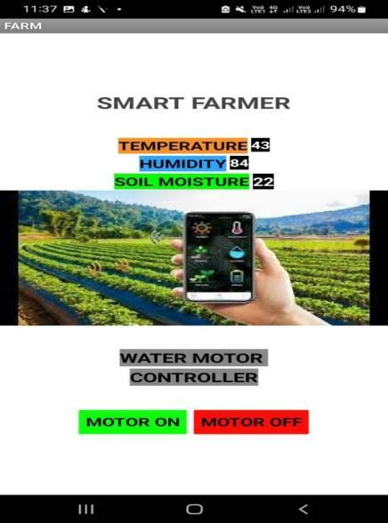
RESULT ON MOBILE APPLICATION

Slide 27
APPLICATIONS
Precision Agriculture
Livestock Monitoring
Agricultural Machinery Management
Irrigation Management
Supply Chain Management

Slide 28
FUTURE SCOPE
Artificial Intelligence and Machine Learning
Robotics
Big Data Analytics
Blockchain
Internet of Things (IoT)

Slide 29
CONCLUSION
Smart farming projects have the potential to transform the agricultural sector by increasing efficiency, reducing waste, and improving yields.
The integration of technologies such as sensors, drones, and artificial intelligence has enabled farmers to collect and analyze data to make informed decisions about crop management, irrigation, livestock management, and more.
One of the key advantages of smart farming projects is their ability to reduce costs and increase profits for farmers.
By using precision agriculture techniques, farmers can reduce inputs such as water and fertilizer, which can result in significant cost savings.
Additionally, smart farming technologies can help to reduce labor costs by automating tasks such as irrigation and monitoring.

Slide 30
REFERENCES
I. “AQUASTAT,” [Online]. Available: http://www.fao.org/aquastat/en/overview/methodology/w ater-use. Accessed on: Mar. 24, 2020.
II. Food and Agriculture Organization of the United Nations. (2017). The Future of Food and Agriculture— Trends and Challenges. Accessed: Jun. 22, 2021. [Online]. Available:http://www.fao.org/3/i6583e/i6583e.pdf
III. Q. T. Minh et al., “A cost-effective smart farming system with knowledge base,” in Proc. 8th Int. Symp. Inf. Commun. Technol., Dec. 2017, pp. 309–316.
IV. A. Mittal, S. Sarangi, S. Ramanath, P. V. Bhatt, R. Sharma, and P. Srinivasu, “IoT-based precision monitoring of horticultural crops— A case-study on cabbage and capsicum,” in Proc. IEEE Global Hum. Technol. Conf. (GHTC), Oct. 2018, pp. 1–7.
V. 68% of the World Population Projected to Live in Urban Areas by 2050, Says UN. Accessed: Mar. 15, 2019. [Online]. Available: https://www.un. org/development/desa/en/news/population/2018-revision- of-worldurbanization-prospects.html
VI. Food Production Must Double by 2050 to Meet Demand From World’s Growing Population. Accessed: Apr. 5, 2019. [Online]. Available: https://www.un.org/press/en/2009/gaef3242.doc.html
VII. Zhang and E. A. Davidson, ‘‘Improving nitrogen and water management in crop production on a national scale,’’ in Proc. AGU Fall Meeting Abstr., Dec. 2018. VIII. How to Feed the World in 2050 by FAO. Accessed: Sep. 6, 2019. [Online]. Available: https://www.fao.org/wsfs/forum2050/wsfs-forum/en/

Slide 31
THANK YOU

